Slide 1

Welcome
Welcome

Slide 2
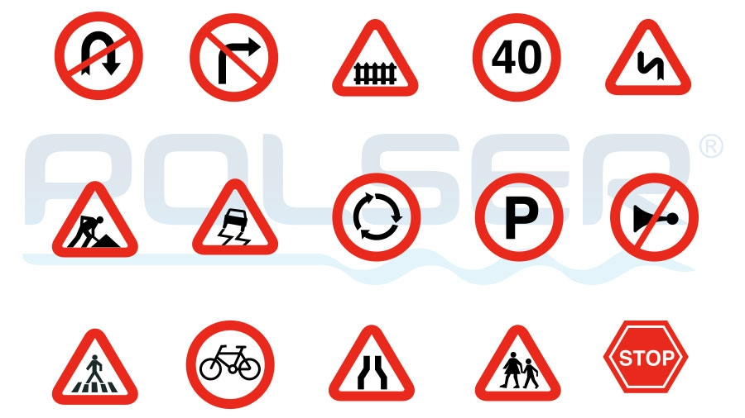
Signboard Prediction
Name : Deepti Horakeri
Batch : B5 July Online
Date : 7 April 2025

Slide 3
Objective:
Classify road signs into 30 categories using CNN.
To predict different road signs.
Build and train a deep learning model for accurate classification.
Aim:
The aim of this project is to build a CNN model to classify road signs into 30 different categories. It focuses on training the model with labeled image data to recognize traffic signs accurately. This system can assist in real-time traffic sign recognition for intelligent transportation and autonomous vehicles.

Slide 4
Dataset details:
Images: The road sign images that will be classified.
Label: 30 classes or categories of road signs (e.g., speed limit, stop sign).
Dataset Split: Distribution of data for training and testing.

Slide 5
Data Preprocessing:
Image Resizing:
Resize all images to a fixed size (eg: 128x128) to ensure uniform input shape for the CCN.
Normalization:
Scale pixel value to the range [0,1] by dividing each pixel by 255 for faster and more stable training.
Label Encoding:
Converting categorical labels into integers or one-hot vectors to make them suitable for classification.
Train-Test-Split:
Split the dataset into training, validation, and test sets.
Data Cleaning:
Removing corrupted or irrelevant images and ensure labels match the image data.

Slide 6
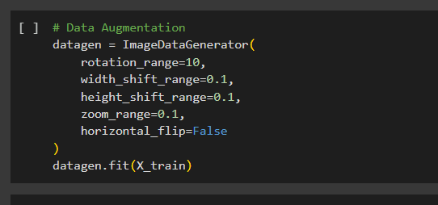
Data Augmentation:

Slide 7
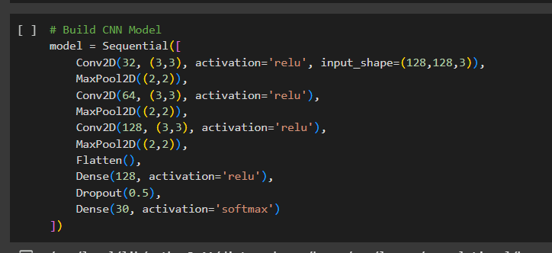
Model Architecture Design:

Slide 8
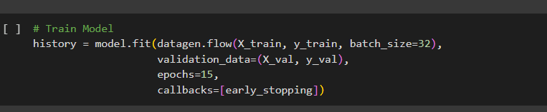
Model Training:

Slide 9
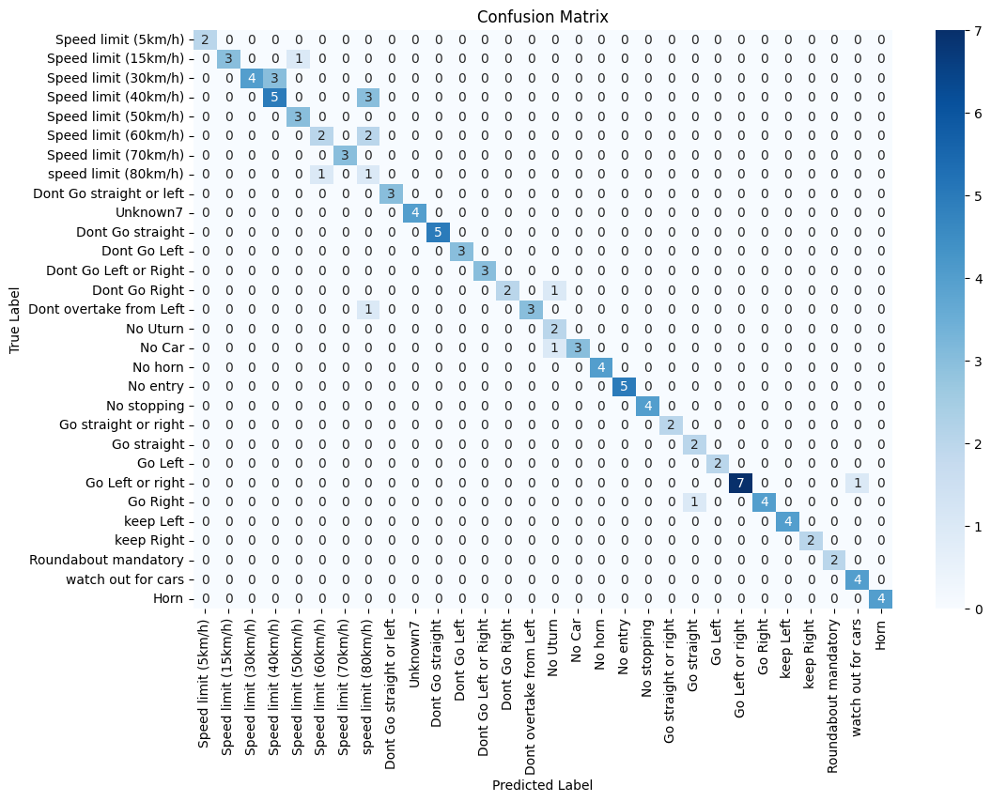
Confusion Matrix:

Slide 10
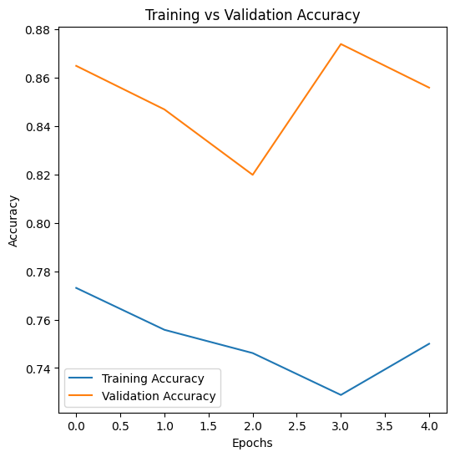
Training vs Validation Accuracy:

Slide 11
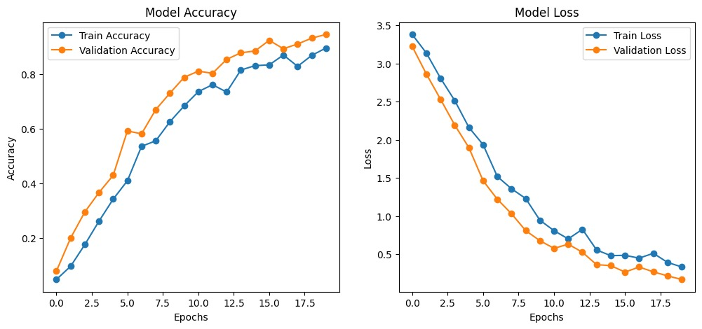
Model Accuracy and Model Loss:

Slide 12
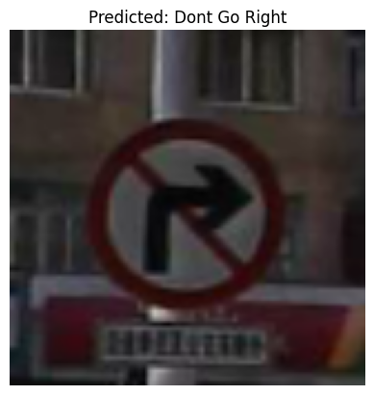
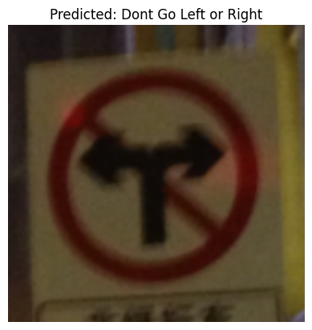
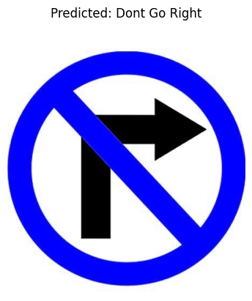
Image from training and test and google pictures:

Slide 13
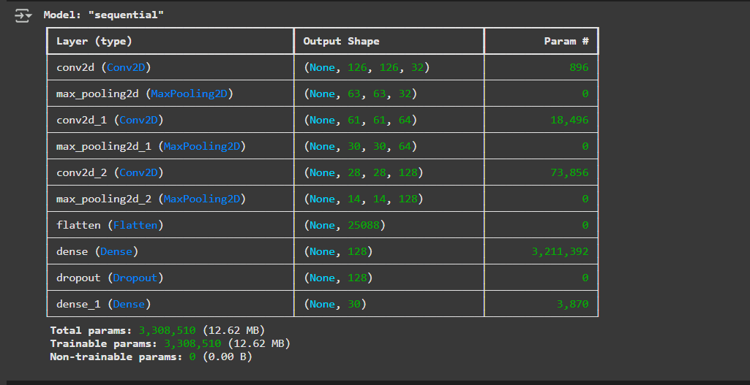
Model Summary:

Slide 14
Conclusion:
Got the accuracy of 0.7568.
Model is predicting multiple pictures correctly.
Can be used in advanced technologies like automated vehicles.

Slide 15
Thank You

